Slide 1
Speaker Recognition
Dylan Shadduck

Slide 2
Outline
Introduction
Pre-processing
Feature Extraction
Unsupervised Clustering
Results
Conclusion

Slide 3
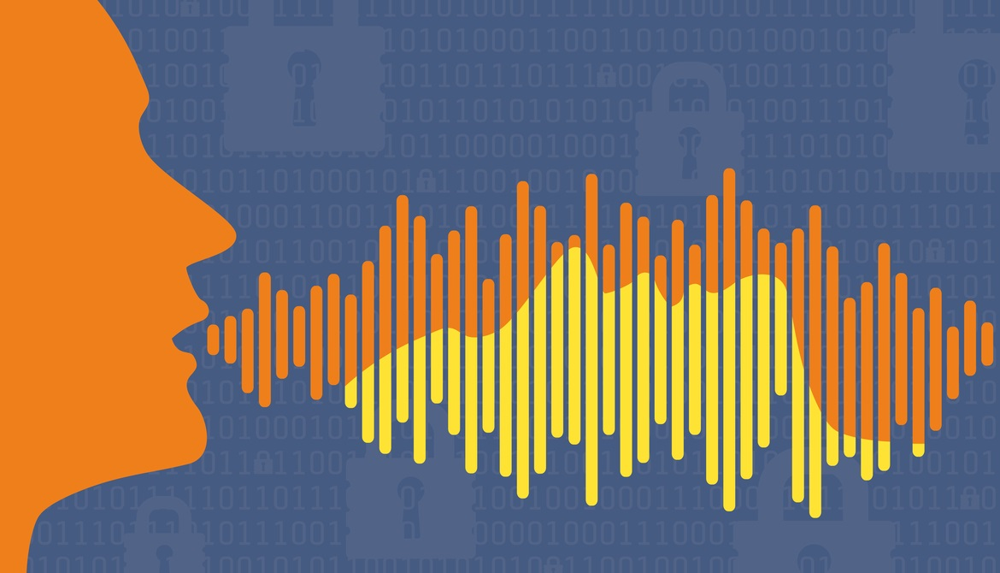
What is Speaker Recognition
Ability to identify different speakers from a given dataset
Easy for humans to do
Difficult for computers to learn

Slide 4
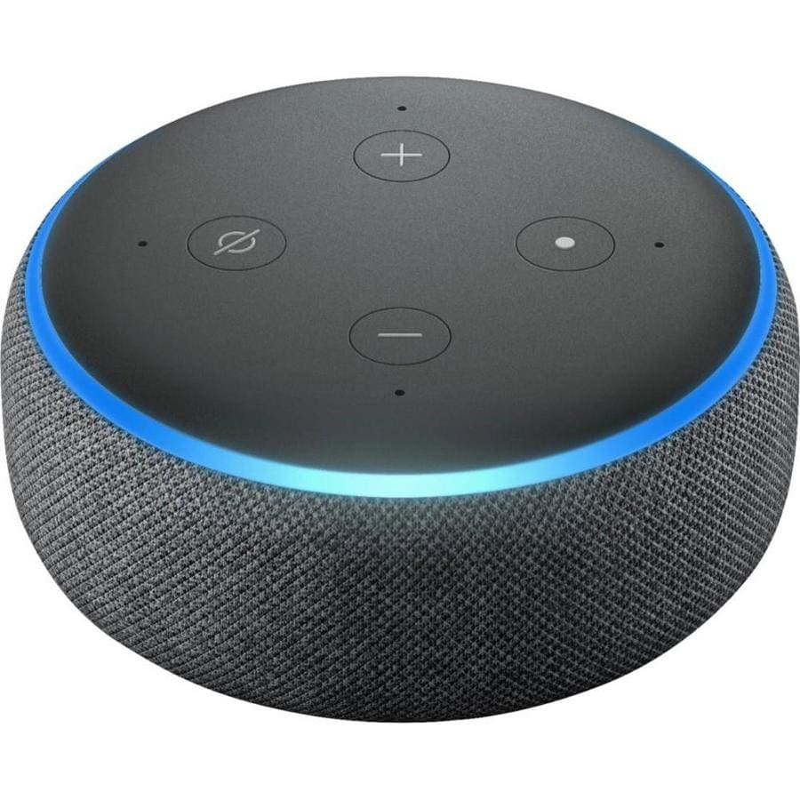
Speaker Recognition Utility
Commonly found in smart devices
Some common uses:
Authentication
Surveillance
Forensics
Nilu Singh, R.A. Khan, Raj Shree, “Applications of Speaker Recognition”
Procedia Engineering Volume 38, 2012, Pages 3122-3126, https://doi.org/10.1016/j.proeng.2012.06.363.

Slide 5
Outline
Introduction
Pre-processing
Feature Extraction
Unsupervised Clustering
Results
Conclusion

Slide 6
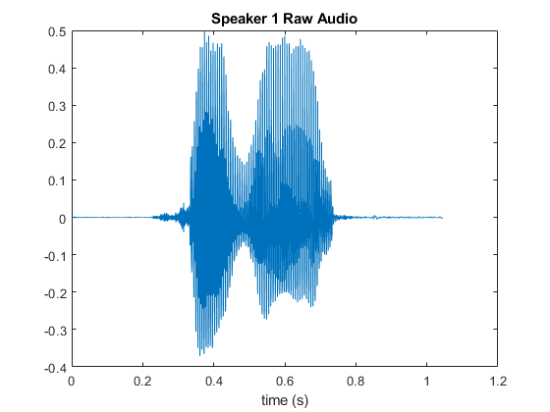
Audio Pre-processing
Start with a raw audio file
Lots of space with no one talking
Different volumes for different speakers

Slide 7
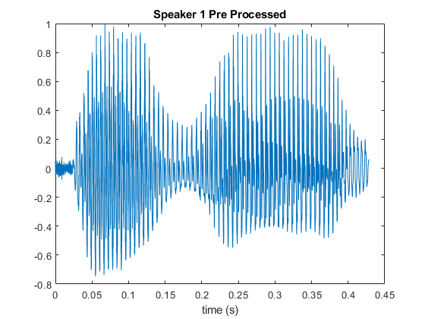
Audio Pre-processing
Normalize Volume
Trim non informational sections
Eliminates unwanted features from our audio signals

Slide 8
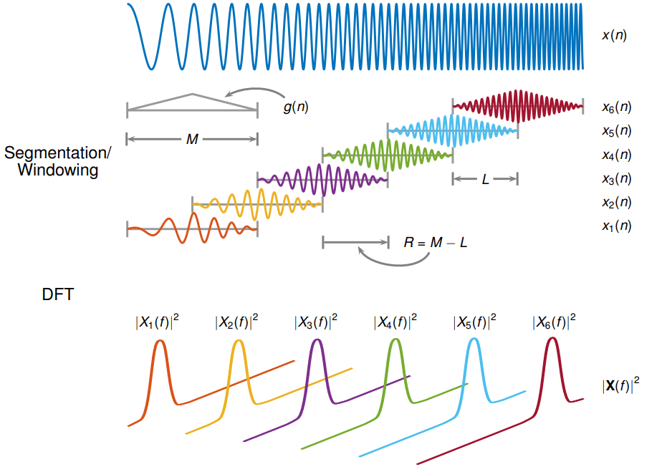
Feature Extraction: STFT
Find the short time fourier transform (STFT)
Frame Blocking
Windowing
FFT Power

Slide 9
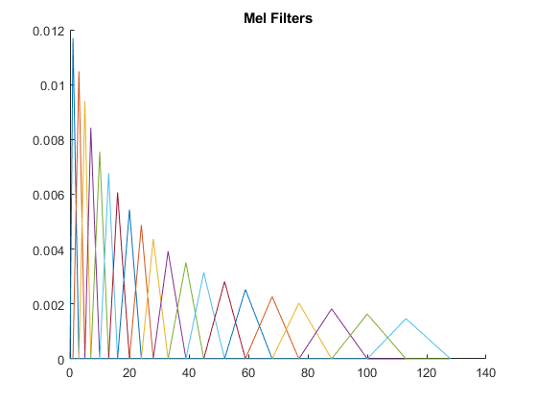
Feature Extraction: Mel Filtering
Mel spectrum is based on human perception of frequencies
Filterbank with K different filters
Filters all have same area
Equal emphasis across frequencies

Slide 10
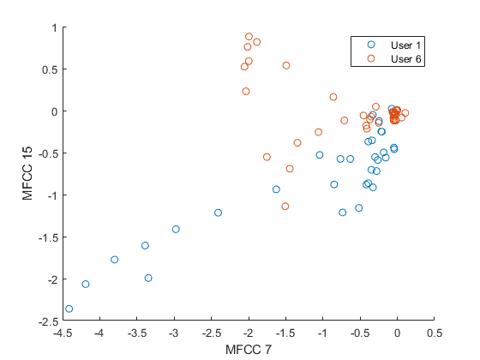
Feature Extraction: Cepstrum Coefficients
Take the Discrete Cosine Transform (DCT) of Mel filtered STFT
Ignore MFCC 0 → corresponds to DC frequency response
Plot shows two dimensions of MFCC for different speakers

Slide 11
Outline
Introduction
Pre-processing
Feature Extraction
Unsupervised Clustering
Results
Conclusion

Slide 12
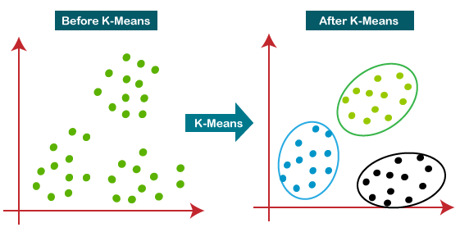
Unsupervised Clustering: K means
Start with audio processed into MFCC’s
Cluster using k means algorithm

Slide 13
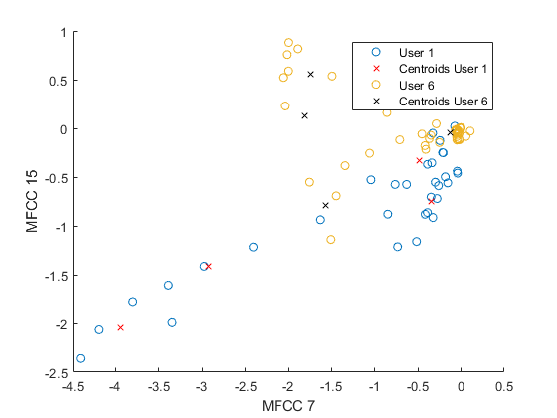
Unsupervised Clustering: Fitting New Data
Find centroids of each cluster for each training speaker
Fit new data to centroids using minimum euclidean distance
Training speaker with smallest distance is best fit

Slide 14
Outline
Introduction
Pre-processing
Feature Extraction
Unsupervised Clustering
Results
Conclusion

Slide 15
Datasets Used
Training Data: 14 speakers saying the word, “zero”
11 speakers from Canvas dataset
3 speakers added from myself and two housemates
Dylan = speaker 12
Picasso = speaker 13
Aaron = speaker 14
Test Data: 15 audio files
11 speakers from Canvas dataset
4 Unique audio files from myself and two housemates
3 added speakers saying, “zero”
1 added file with Picasso saying, “seven”

Slide 16
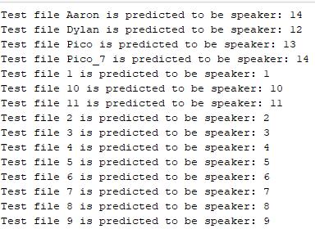
Results: Speaker Prediction
Train our model using k means algorithm
Make predictions by finding model with smallest sum euclidean distance
Accuracy: 93.3%

Slide 17
Conclusion
MFCC feature extraction
K means clustering algorithm
Predictions by minimizing Euclidean Distance
We find 93.3 % accuracy
This model does not perform well with unique words
Larger training dataset with longer sentences would provide a better model

